Slide 1
Diocese of Fort Wayne – South Bend
Overview for Parish Point Persons
Eucharistic Revival
Beginning Corpus Christi Sunday June 19, 2022

Slide 2
Agenda
The National Eucharistic Revival
The Eucharistic Revival in our Diocese
Information for Point Persons

Slide 3
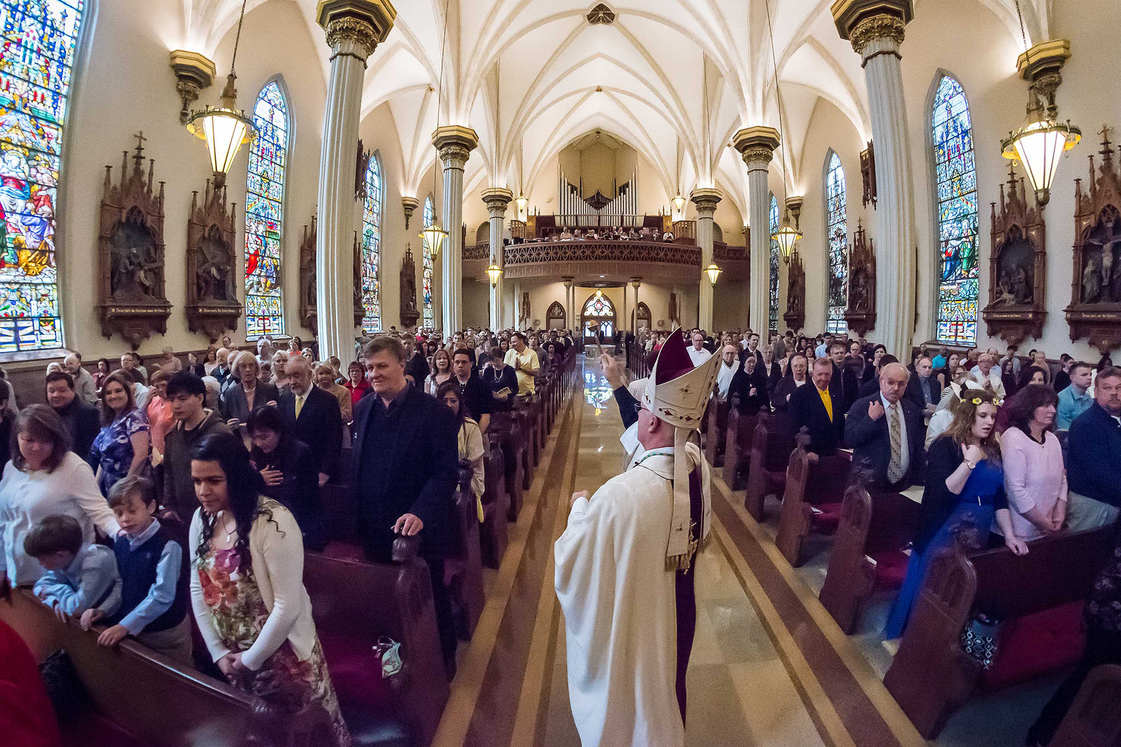
Introduction
The National Eucharistic Revival is a top-down and bottom-up/grassroots multi-year initiative
In our diocese, we are inviting apostolates and movements to participate in defined initiatives and to jump in with their own initiatives

Slide 4
National Eucharistic Revival

Slide 5
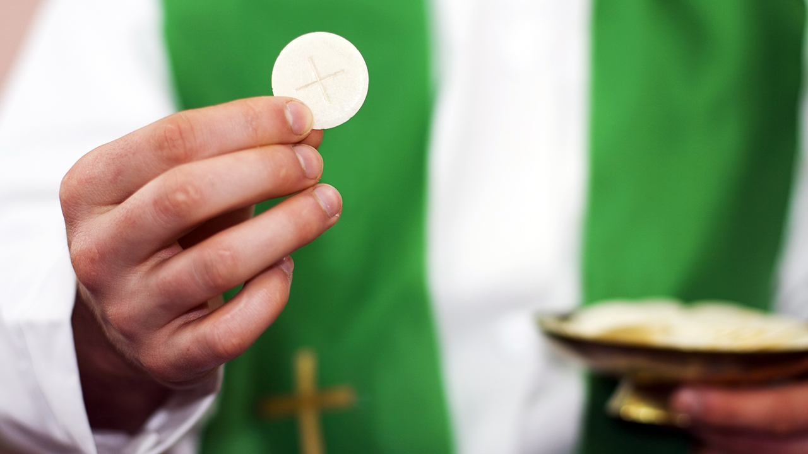
Introduction
Spurred by 2019 Pew Research study suggesting that only about 1/3 of US Catholics believe the Church’s teaching the the Eucharist is the Body, Blood, Soul and Divinity of Christ [CCC 1374]
Confirmed by 2021 Pillar study showing only 50% of Catholics attending mass at least weekly believe in the Real Presence
Pandemic’s impact on Mass attendance has made the initiative even more important

Slide 6
Mission and Vision
The Mission: To renew the Church by enkindling a living relationship with the Lord Jesus Christ in the Holy Eucharist.
Year of Preparation
Diocesan
Year
Parish
Year
National Eucharistic Congress
July 17-21 Indianapolis
Corpus Christi
Sunday, Jun 2022
Corpus Christi
Sunday, Jun 2023
June
2024
The Vision: A movement of Catholics across the United States, healed, converted, formed, and unified by an encounter with Jesus in the Eucharist – and sent out in mission “for the life of the world.”

Slide 7
Strategic Pillars
Foster encounters with the living person of Jesus through kerygmatic proclamation and transformational experiences of Jesus through Eucharistic devotion
Contemplate and proclaim the full doctrine of the Real Presence of Jesus in the Eucharist through the Truth of our teaching, Beauty of our worship, and Goodness of a life of service
Empower grassroots creativity by partnering with movements, apostolates, and educational institutions
Reach the smallest unit: parish small groups and families
Embrace and learn from the various rich intercultural Eucharistic traditions.

Slide 8
Catechetical & Media Partners: Mobilizing the “grassroots”
McGrath Institute
Our Sunday Visitor
Augustine Institute
Aleteia
Catholic Apostolate Center
EWTN and Ave Maria Radio
Franciscan University of Steubenville
Hallow
Magis Center
Magnificat Magazine
Real Life Catholic
Relevant Radio
Word on Fire
Formed.org platform for free digital resources
Knights of Columbus Training Materials for planning Eucharistic Processions

Slide 9
Apostolates & Collaborators: Animating a “bottom up” Eucharistic Movement
Catholic Campus Ministry Association
Catholic Leadership Institute
Catholic Missionary Disciples
CHARIS
Conference of Major Superiors of Men
Conference of Major Superiors of Women
Federation of Diocesan Liturgical Comm.
FOCUS
Franciscan University of Steubenville
Hispanic Catholic Charismatic Renewal
In Word and Witness
Knights of Columbus
Knights of Peter Claver
Legatus
LifeTeen
MovCom: Ecclesial movements & communities
National Catholic Council for Hispanic Ministry
NET Ministries
NFCYM
National Black Catholic Conference
St. Paul’s Outreach
St. Paul Street Evangelization
The Thomistic Institute
Vietnamese Eucharistic Youth Movement

Slide 10
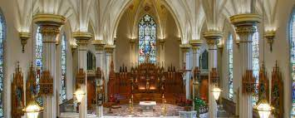
Eucharistic Revival
Diocese of Fort-Wayne South Bend

Slide 11
Diocesan and Parish Years
Diocesan Year (Jun ’22 – Jun ‘23)
Kickoff Revival in our diocese - Eucharistic Procession and Festival (19 Jun ‘22)
Recruit and form leaders across the diocese to execute Parish-year initiatives
Apostolates & Movements
Parish Point Persons
Parish Music & Liturgy Directors
Youth Ministers
Catholic Educators
Recruit and train diocesan Eucharistic speakers
Parish Year (Jun ’23 – Jun ‘24)
Recruit, Form & Train Parish Eucharistic Evangelists; Evangelize the Eucharist
Form parish leaders (ministry, small group, etc)
Apostolates, movements & religious communities provide events
Parish schools & ministries focus on Eucharist
Parish Eucharistic Processions & 40 Hours
Teaching Masses & Eucharistic homilies
Parishes & Families use Formed.Org Eucharist content

Slide 12
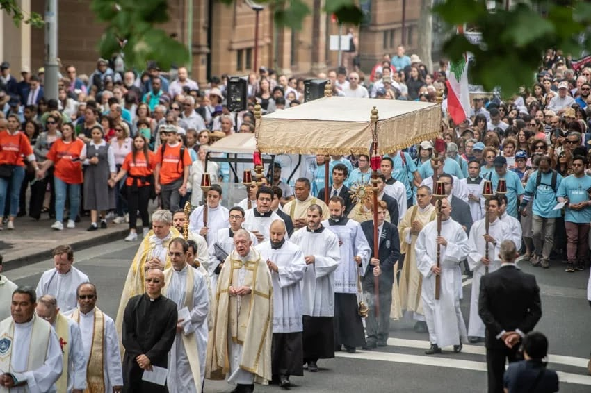
Eucharistic Procession & Festival Corpus Christi Sunday, 19 June 2022, Warsaw, IN
A fitting inauguration to the national Eucharistic Revival in our diocese

Slide 13
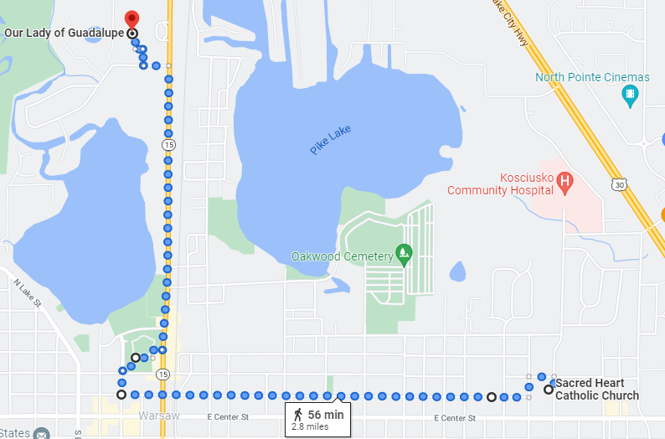
Procession
Station 3
2:30 to 5:00 pm, with several thousand expected, led by Bishop Kevin C. Rhoades
Route from Sacred Heart to Our Lady of Guadalupe parish. 2.8 miles. Stations at both end point, one station in Central Park
Choirs expected include the ND Children’s choir, Catholic Young Adult Choir
Ethnic groups and choirs from across the diocese (Hispanic, Burmese, Vietnamese, Filipino, Nigerian) in traditional attire and leading traditional ethnic hymns
Apostolate signage/banners and shirts are welcome
Station 2
Central Park
Station 1

Slide 14
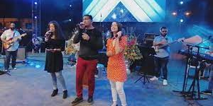
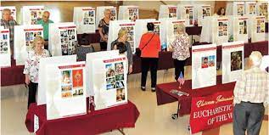
Festival
Begins immediately after conclusion of Eucharistic procession on the grounds of Our Lady of Guadalupe Parish. Approximately 5 pm to 7 pm.
Praise & Worship. International bi-lingual Catholic praise & worship band.
Catechesis. Catechetical material on the Eucharist. Eucharistic miracles exhibit.
Apostolates & Organizations. Tables & booths for educating the faithful about the excellent Catholic groups in our diocese
Food. Traditional Burmese, Hispanic, Filipino, Nigerian and Vietnamese dishes
Signage. Groups welcome to display banners & signage at the festival.

Slide 15
Point Person “Job Description”
Serve as the parish's primary contact with the Diocesan Point Person for the Revival
Serve as the parish's point of reference for the pastor, parish ministries and regional apostolates regarding the Eucharistic Revival
Forward Revival information received from the diocese to the pastor and parish leadership team
Coordinate with the pastor and parish leadership team to identify new and existing parish initiatives that can support this process
Collaborate with other parish point persons on ideas and best practices via the Diocesan Revival collaboration webpage
In support of the pastor, coordinate the development and maintenance of a parish blueprint for the Revival, including a calendar of Revival activities. Post the blueprints to the Diocese's Revival collaboration webpage.

Slide 16
Point Person Characteristics
Practicing Catholic in good standing with the Church
Familiar with parish organization, ministries, and processes
Have a desire to renew the Church by enkindling a living relationship with the Lord Jesus in the most Holy Eucharist
Have responded to the call to live as a missionary disciple and have been prompted in their hearts to share that call with others
Complete the Revival's Eucharistic missionary formation program
Capable of galvanizing parishioners into action with the joy and zeal of missionary discipleship
Lead collaboratively with charity, patience, humility, empathy, and authenticity
Prayerful and organized, coupled with the ability to prudently discern and engage others
Willing and able to devote some time during the workday, and possibly on evenings or weekends as necessary

Slide 17
Point Person Job Information
Time Period. The position will run for the duration of the Revival, from February 2022 through the National Eucharistic Congress in July of 2024.
Formation. The formation will likely occur at a location within a one-hour drive, but remote formation may be possible as well. The formation material is being created by the USCCB for adaptation as appropriate by each diocese.
Time Commitment. ​The time commitment is expected to vary, with a larger amount during the parish planning phase and a lesser amount during the execution phase, with temporary surges in the proximity of parish events. The amount of time during the execution phase would be based on the extent to which the point person is assigned the responsibility for individual events. Overall a few hours per week is estimated on average. There may some weeks where there no work is required.
Travel. ​No travel, except for the formation.
Meetings. It is anticipated that the large majority of meetings would be within the parish. The only face-to-face meeting envisioned at this time is the formation. There will be an opportunity to collaborate with other parish point persons electronically. Occasional "Zoom" meetings might evolve from this.
Guidance. The diocesan point person is available to answer questions and provide guidance as needed.

Slide 18
Parish Timeline - Year of Preparation (1 of 2)
Now. Diocesan Revival website online. (diocesefwsb.org/eucharist)
Thu Feb 24. Parish toolkit (initial version) available on diocesan Revival website
Fri Feb 25. Zoom. Revival overview & initial schedule of activity. Q&A. Presented by Diocesan Point Person..
Early to mid March
Diocese will include Revival promotions in weekly communications to parishes for 3 weeks in a row - save the date and call out for volunteers - directed to the website.
Procession & Festival "save the date" bulletin text/graphic and pulpit announcement from Diocese
Parishes begin encouraging parishioners to register for the Procession/Festival on the Diocesan website.
Spring TBD. Formation event for parish point persons

Slide 19
Parish Timeline - Year of Preparation (2 of 2)
Fri Apr 1. Bishop invitation video available on Revival website for including in parish communications
April. Revival T-Shirts template available in English and Spanish to each parish/apostolate to order on their own, parishes encouraged to promote parishioners to wear these. Procession banners/signs can be created by parishes on their own if desired (no template).
Apr 17 – Apr 30. Qty TBD Procession & Festival 11 x 17" posters available from diocese for posting in parishes
Thu May 19. Procession & Festival final bulletin text/graphic, pulpit announcement, Facebook announcement from Diocese. On toolkit and in weekly communications from diocese starting on this date up until event.
Fri May 20. Parishes provide preliminary count of parishioners who wish to ride diocesan bus.
Fri Jun 10. Parishes provide final count of parishioners who wish to ride diocesan bus

Slide 20
Parish Timeline (Diocesan Year)
Sun Jun 19
Final pulpit announcement about Procession/Festival (already provided by diocese)
Parishes participate in Procession and Festival in Warsaw
Jun 20 - Dec 20. Coordinate with pastor and staff to develop parish blueprint
Sep & Nov. Parish youth ministers participate in Eucharistic formation
Dec 20 ‘22 - Jun 18 ‘23. Plan and recruit for each parish initiative
Dec 20 ‘22 - Jun 18 ‘23. Plan and prepare for launching Eucharistic formation in religious education and catholic schools, leveraging material provided by diocese and USCCB.
Jan 2023. Parish music/liturgy directors participate in Eucharistic formation [ Nov '22 for Hispanics]
Apr 2023. Parish educators participate in Sat afternoon Eucharistic formation in Warsaw

Slide 21
Parish Timeline (Parish Year)
Jun ‘23. Parish Eucharistic evangelization training
Jun '23-Jun ‘24
Parish Eucharistic evangelization
Parish initiatives (see earlier slide)
Jul ‘23. Begin promotion for National Eucharistic Congress in Indianapolis in Jul 2024.

Slide 22
Resources for Parish Point Persons
Diocesan Revival Website: Eucharistic Revival - The Catholic Diocese of Fort Wayne-South Bend (diocesefwsb.org)
Diocesan Toolkit for Parishes & Apostolates: Eucharistic Revival Toolkit - The Catholic Diocese of Fort Wayne-South Bend (diocesefwsb.org)
USCCB Doctrine on Eucharist: 7-703 The Mystery of Eucharist, for RE-UPLOAD, JANUARY 2022.pdf (usccb.org)
USCCB Website: National Eucharistic Revival | My Flesh for the Life of the World - see first video clip in particular
USCCB Short Course on Eucharist: Revive Parishes

