Slide 1
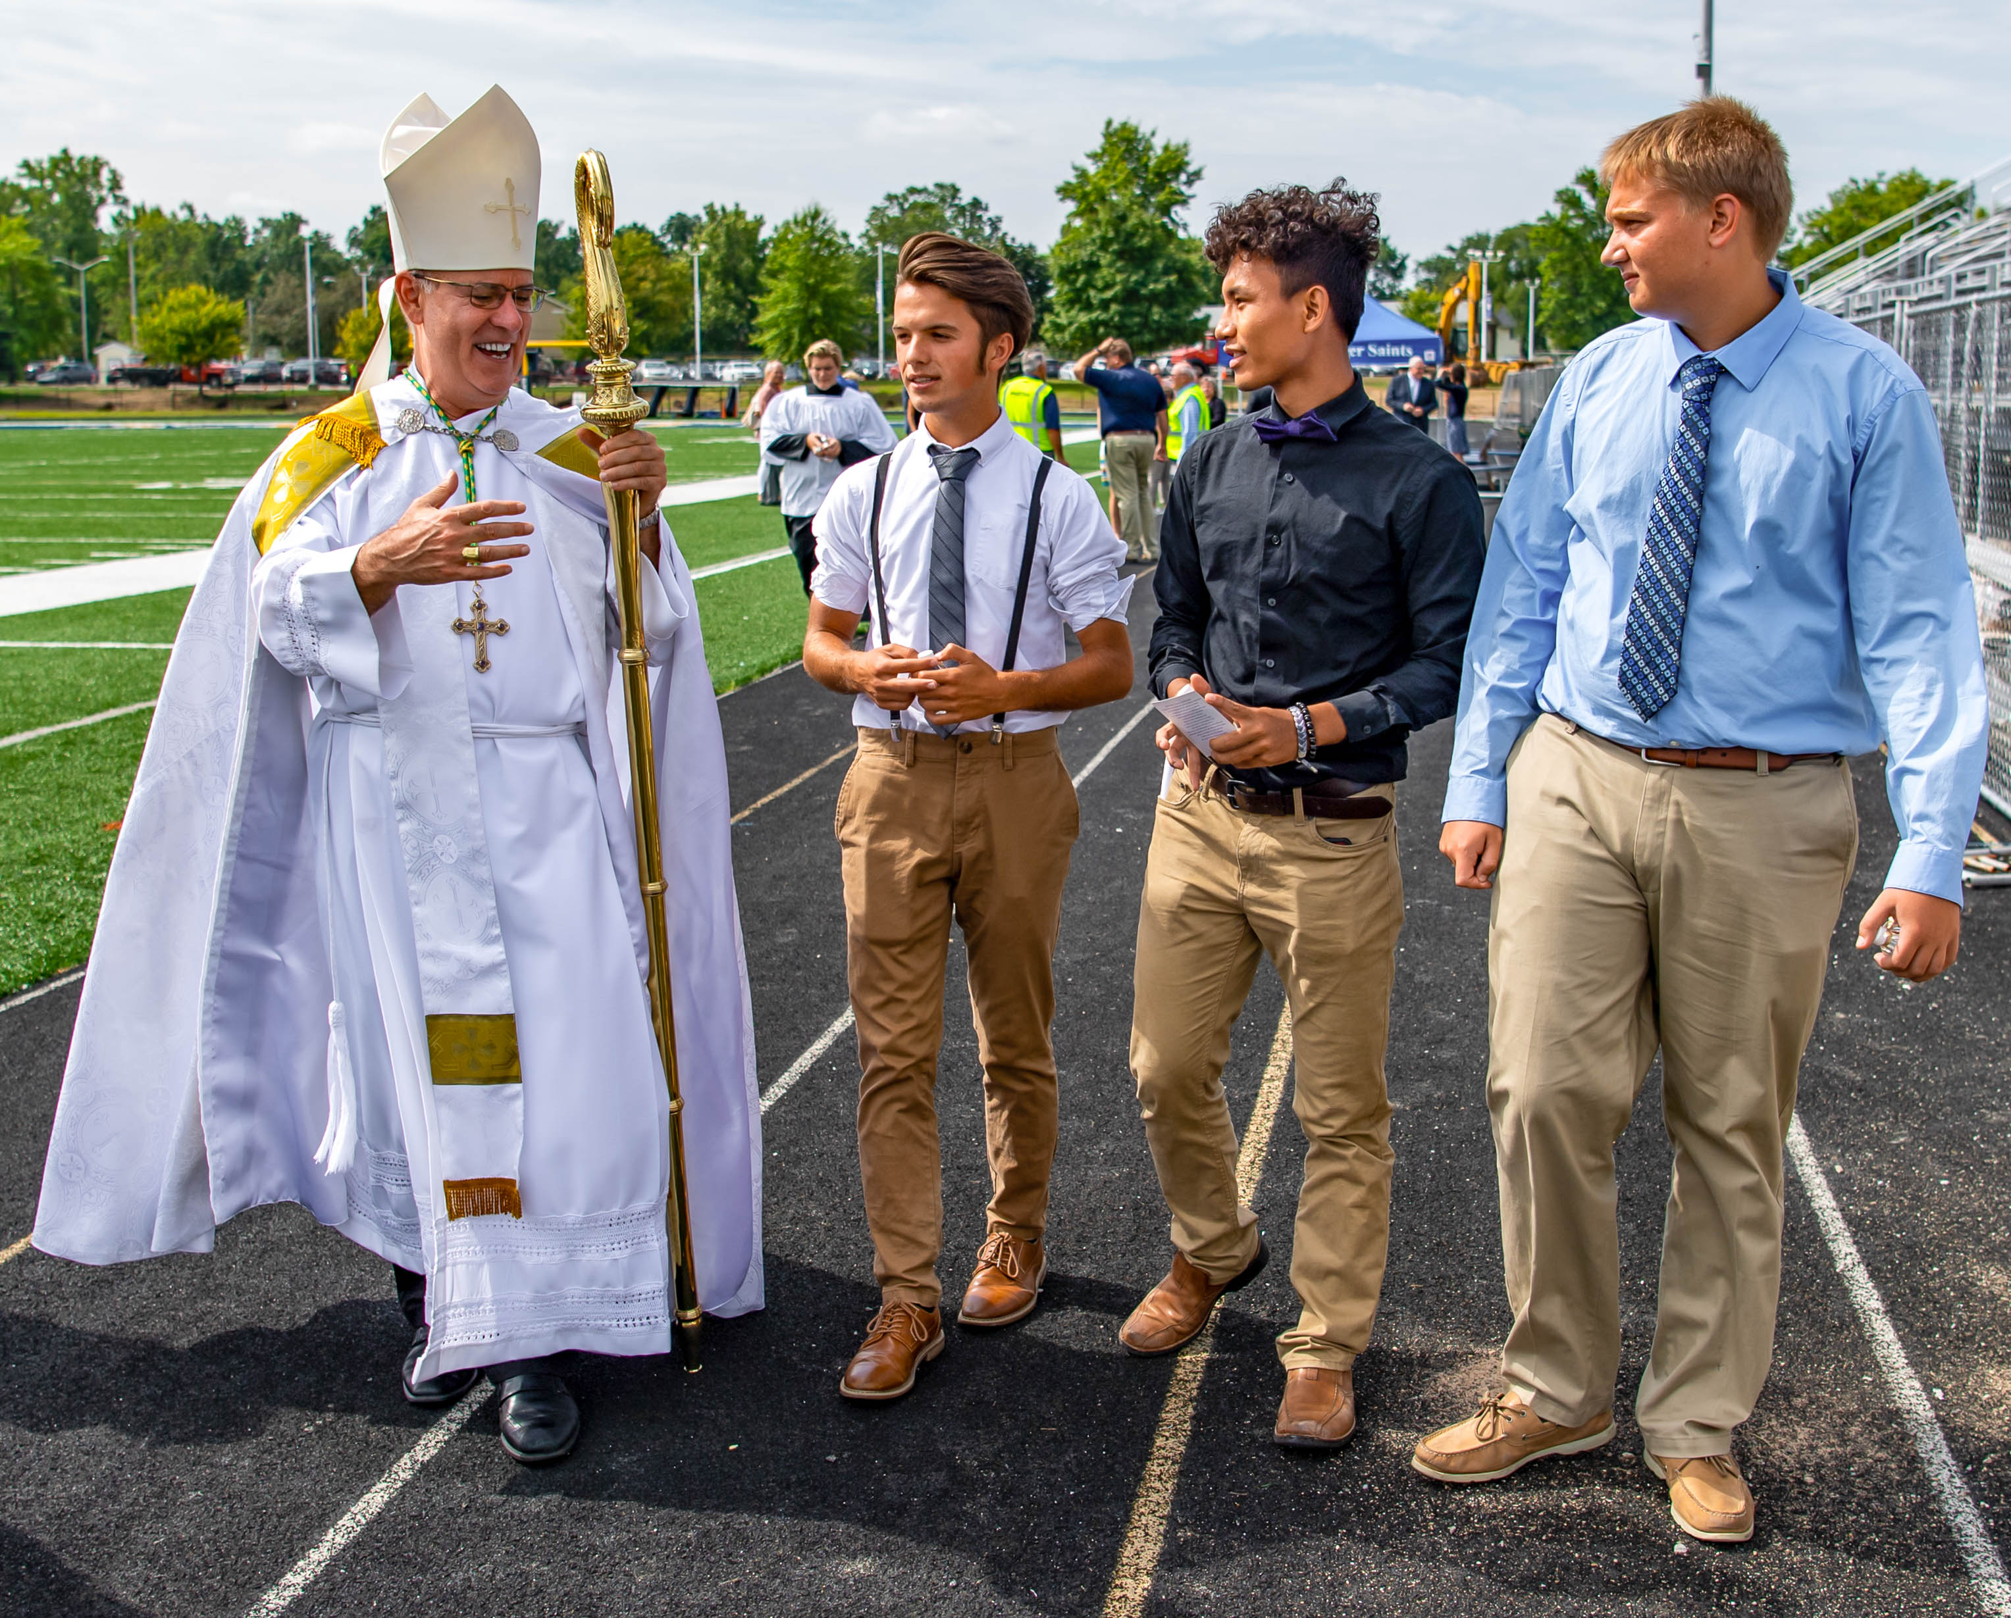
AFFORDING A
CATHOLIC
EDUCATION

Slide 2
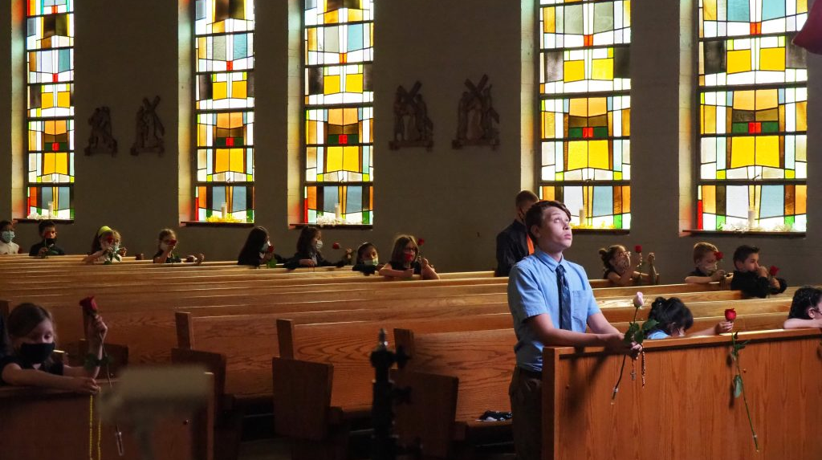
An Education for Eternity
Students develop a personal relationship with Jesus within His mystical body, the Church
Catholic schools are faith-filled communities where students are known and loved
Our schools help to form students into disciples of Christ
Notes:
Funded by private, charitable donations, Scholarship Granting Organizations provide scholarships to income eligible students to offset tuition costs at partnering schools. SGOs are part of the School Scholarship Tax Credit Program.
The Scholarship Granting Organization of Northeast Indiana (SGONEI) was founded in 2011. Our 43 Catholic schools in the Diocese of Fort Wayne-South Bend partner with the Institute for Quality Education as the Scholarship Granting Organization of Northeast Indiana.

Slide 3

An Education for Eternity
We help students to fulfill their destinies to become saints
The ultimate goal of Catholic education is to form students for heaven
Catholic schools help to develop students’ minds, bodies, and soul​s.
The Catholic school assists parents, who are the primary educators of their children, in meeting their responsibility of educating their children in the teachings of the Catholic Church and of living a Catholic way of life.
Notes:
Funded by private, charitable donations, Scholarship Granting Organizations provide scholarships to income eligible students to offset tuition costs at partnering schools. SGOs are part of the School Scholarship Tax Credit Program.
The Scholarship Granting Organization of Northeast Indiana (SGONEI) was founded in 2011. Our 43 Catholic schools in the Diocese of Fort Wayne-South Bend partner with the Institute for Quality Education as the Scholarship Granting Organization of Northeast Indiana.

Slide 4
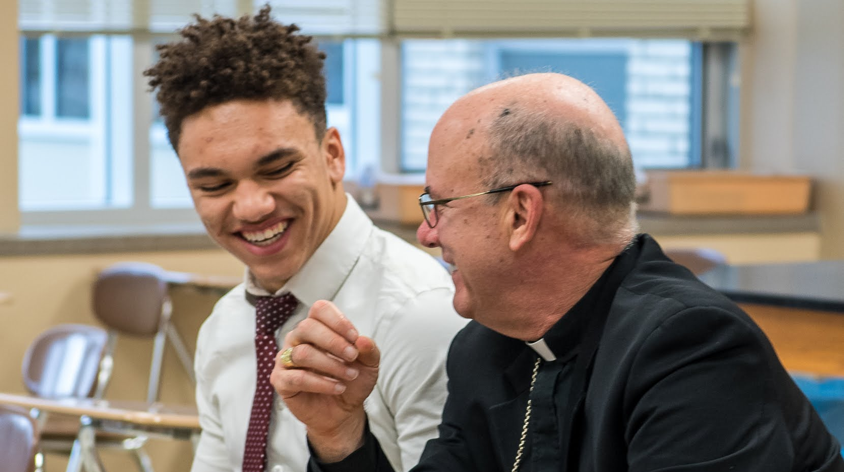
Scholarship Granting Organizations
Provides scholarships to income eligible students
Funded by private, charitable donations
SGOs are part of the School Scholarship Tax Credit Program.
The Scholarship Granting Organization of Northeast Indiana (SGONEI) was founded in 2011 to provide scholarships to attend the Catholic schools of the Diocese of Fort Wayne-South Bend.
Notes:
Funded by private, charitable donations, Scholarship Granting Organizations provide scholarships to income eligible students to offset tuition costs at partnering schools. SGOs are part of the School Scholarship Tax Credit Program.
The Scholarship Granting Organization of Northeast Indiana (SGONEI) was founded in 2011. Our 43 Catholic schools in the Diocese of Fort Wayne-South Bend partner with the Institute for Quality Education as the Scholarship Granting Organization of Northeast Indiana.

Slide 5
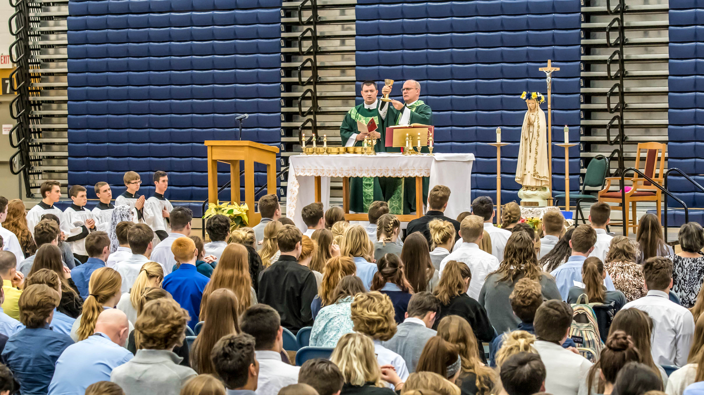
INDIANA CHOICE SCHOLARSHIP
Provides scholarships to eligible students
State funded
program
Nearly half of our students receive a Choice Scholarship
Also referred to as the voucher program, the Indiana Choice Scholarship program provides state funding to families of qualifying students to offset tuition.
Notes:
Funded by private, charitable donations, Scholarship Granting Organizations provide scholarships to income eligible students to offset tuition costs at partnering schools. SGOs are part of the School Scholarship Tax Credit Program.
The Scholarship Granting Organization of Northeast Indiana (SGONEI) was founded in 2011. Our 43 Catholic schools in the Diocese of Fort Wayne-South Bend partner with the Institute for Quality Education as the Scholarship Granting Organization of Northeast Indiana.

Slide 6
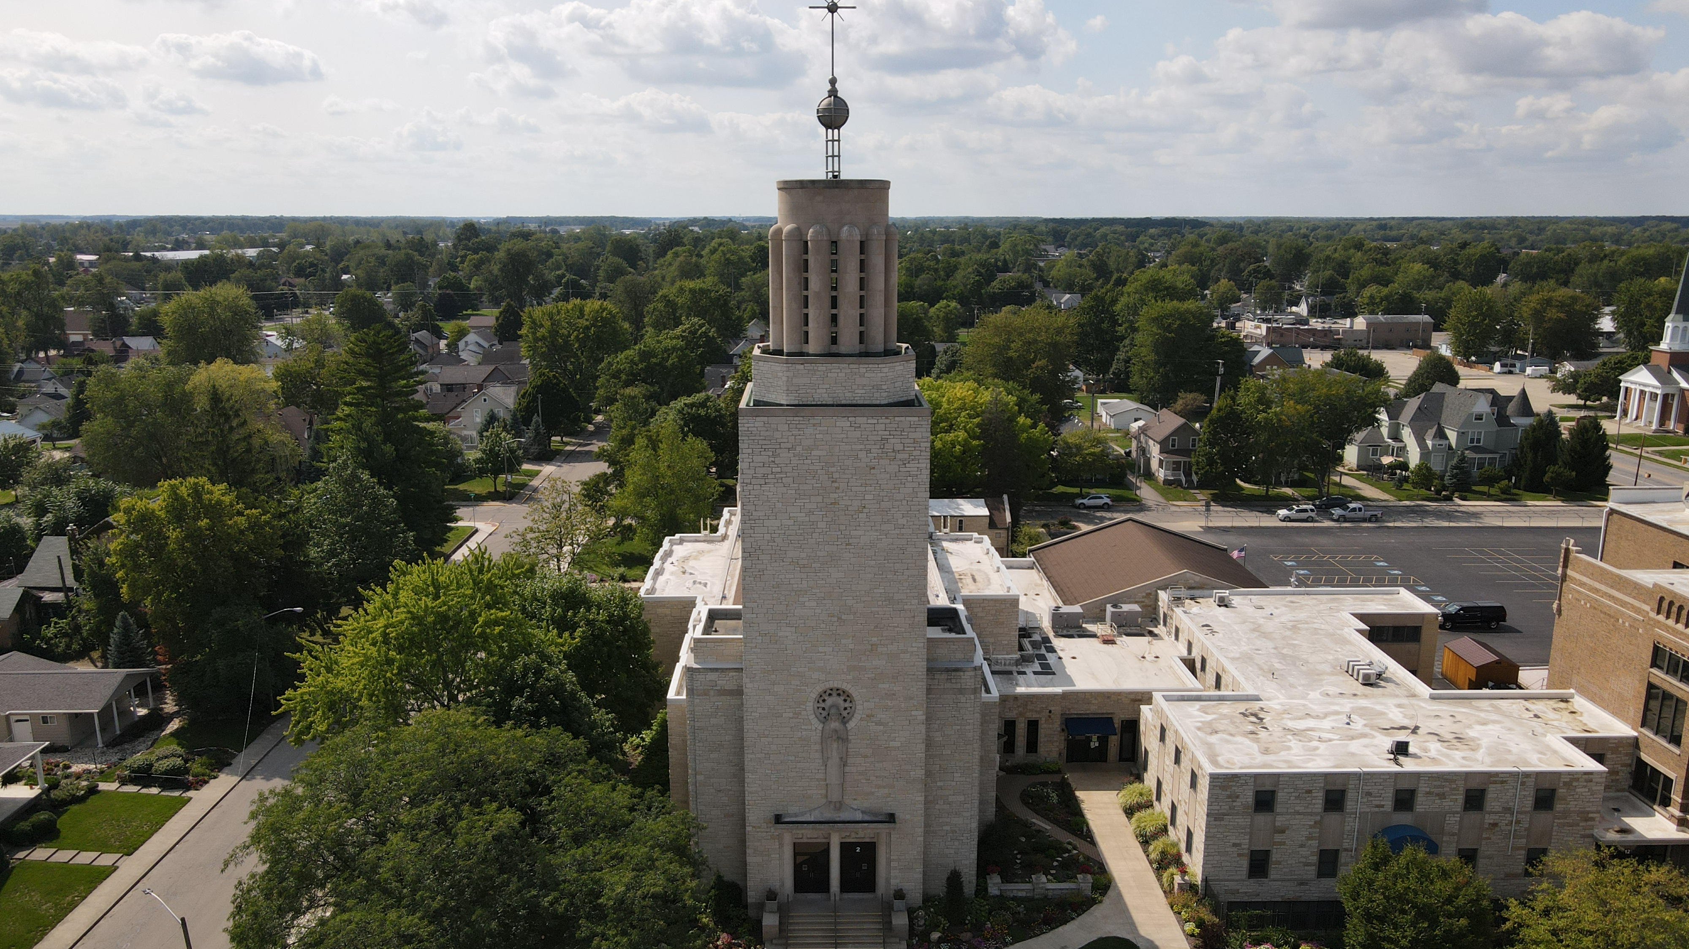

STUDENT-BASED REQUIREMENTS
Qualifying students have an annual household income of less than 300% of the Federal Reduced Lunch guidelines.
*Income limits based on 300% Federal Reduced Lunch Guidelines, 2022-23
Notes:
Funded by private, charitable donations, Scholarship Granting Organizations provide scholarships to income eligible students to offset tuition costs at partnering schools. SGOs are part of the School Scholarship Tax Credit Program.
The Scholarship Granting Organization of Northeast Indiana (SGONEI) was founded in 2011. Our 43 Catholic schools in the Diocese of Fort Wayne-South Bend partner with the Institute for Quality Education as the Scholarship Granting Organization of Northeast Indiana.

Slide 7
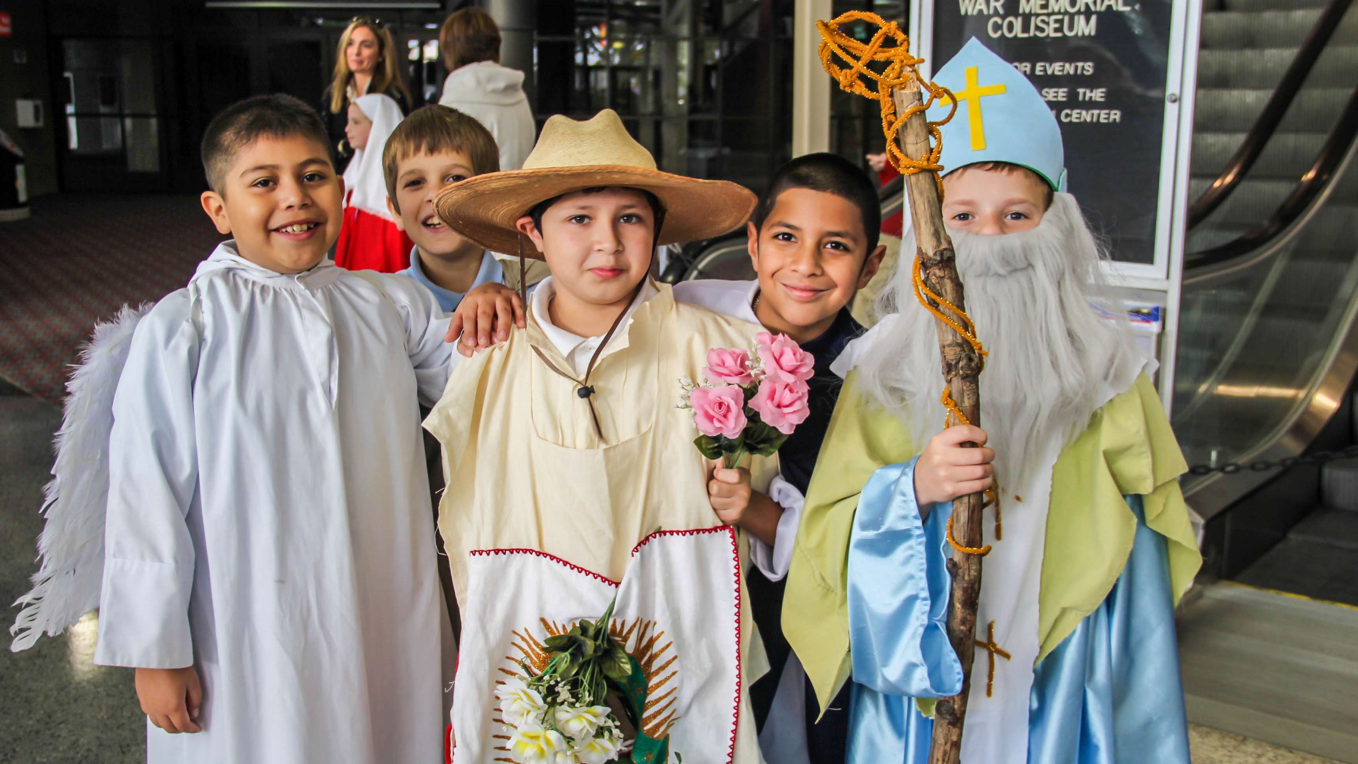
STUDENT-BASED REQUIREMENTS
Indiana Choice Scholarship
The student must reside in Indiana
The household’s annual income must be less than 300% of the Federal Reduced Lunch guidelines
Each student must meet one of eight program tracts determined by the Choice Scholarship program
Your principal will work with you to discover if you meet the three criteria
Notes:
Funded by private, charitable donations, Scholarship Granting Organizations provide scholarships to income eligible students to offset tuition costs at partnering schools. SGOs are part of the School Scholarship Tax Credit Program.
The Scholarship Granting Organization of Northeast Indiana (SGONEI) was founded in 2011. Our 43 Catholic schools in the Diocese of Fort Wayne-South Bend partner with the Institute for Quality Education as the Scholarship Granting Organization of Northeast Indiana.

Slide 8
ELIGIBILITY TRACKS
Indiana Choice Scholarship
PREVIOUS SGO
AWARD TRACK
SIBLING
TRACK
SPECIAL ED
TRACK
Previous Choice Scholarship Track
Student has received a scholarship award from an approved SGO in a previous school year.
Student has a sibling who received either a Choice Scholarship or a scholarship from an approved SGO in a preceding school year.
The student must have a disability that requires special education services, an IEP or a Service Plan has been developed for the student.
The student must have received a Choice Scholarship in a preceding school year.
Unless otherwise stated, prior school years do not have to immediately precede the school year for which the student is applying for a Choice Scholarship.
Notes:
Funded by private, charitable donations, Scholarship Granting Organizations provide scholarships to income eligible students to offset tuition costs at partnering schools. SGOs are part of the School Scholarship Tax Credit Program.
The Scholarship Granting Organization of Northeast Indiana (SGONEI) was founded in 2011. Our 43 Catholic schools in the Diocese of Fort Wayne-South Bend partner with the Institute for Quality Education as the Scholarship Granting Organization of Northeast Indiana.

Slide 9
ELIGIBILITY TRACKS
Indiana Choice Scholarship
ON MY WAY
PRE-K PATHWAY
2 SEMESTERS IN A PUBLIC SCHOOL
“F” PUBLIC SCHOOL PATHWAY
Foster
Track
The student must have received and used an Early Education Grant to attend Pre-K at an eligible Choice Scholarship school and must be applying for a Choice Scholarship at the same school.
The student must have been enrolled in kindergarten through grade 12 in a public school in Indiana for at least two semesters immediately preceding the first semester for which the individual receives a Choice Scholarship.
The student must be required to attend a specific public school based on their residence that has been assigned an “F” grade. (This track does not require prior attendance at the school.)
A student must be placed in foster care. Foster children are automatically income-eligible for the Choice Scholarship Program. Supporting documentation of foster care must be provided at the time of application.
Notes:
Funded by private, charitable donations, Scholarship Granting Organizations provide scholarships to income eligible students to offset tuition costs at partnering schools. SGOs are part of the School Scholarship Tax Credit Program.
The Scholarship Granting Organization of Northeast Indiana (SGONEI) was founded in 2011. Our 43 Catholic schools in the Diocese of Fort Wayne-South Bend partner with the Institute for Quality Education as the Scholarship Granting Organization of Northeast Indiana.

Slide 10

Q.
What is the
Choice scholarship amount?
Qualifying families are eligible for a scholarship amounting to 90% of what it costs to educate that student in the public school system in which the school resides.
Notes:
Funded by private, charitable donations, Scholarship Granting Organizations provide scholarships to income eligible students to offset tuition costs at partnering schools. SGOs are part of the School Scholarship Tax Credit Program.
The Scholarship Granting Organization of Northeast Indiana (SGONEI) was founded in 2011. Our 43 Catholic schools in the Diocese of Fort Wayne-South Bend partner with the Institute for Quality Education as the Scholarship Granting Organization of Northeast Indiana.

Slide 11
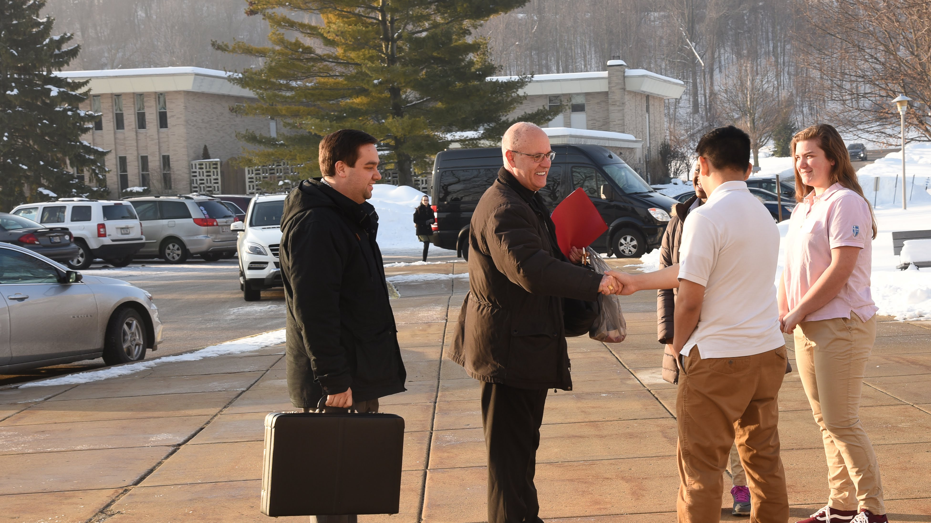
Q.
How is Choice different than Scholarship Granting Organization (SGO) scholarships?
Choice Scholarships:
Publicly funded
Eligibility Track Requirements
SGO Scholarships
Private Donor funded
No track requirements
Notes:
Funded by private, charitable donations, Scholarship Granting Organizations provide scholarships to income eligible students to offset tuition costs at partnering schools. SGOs are part of the School Scholarship Tax Credit Program.
The Scholarship Granting Organization of Northeast Indiana (SGONEI) was founded in 2011. Our 43 Catholic schools in the Diocese of Fort Wayne-South Bend partner with the Institute for Quality Education as the Scholarship Granting Organization of Northeast Indiana.

Slide 12
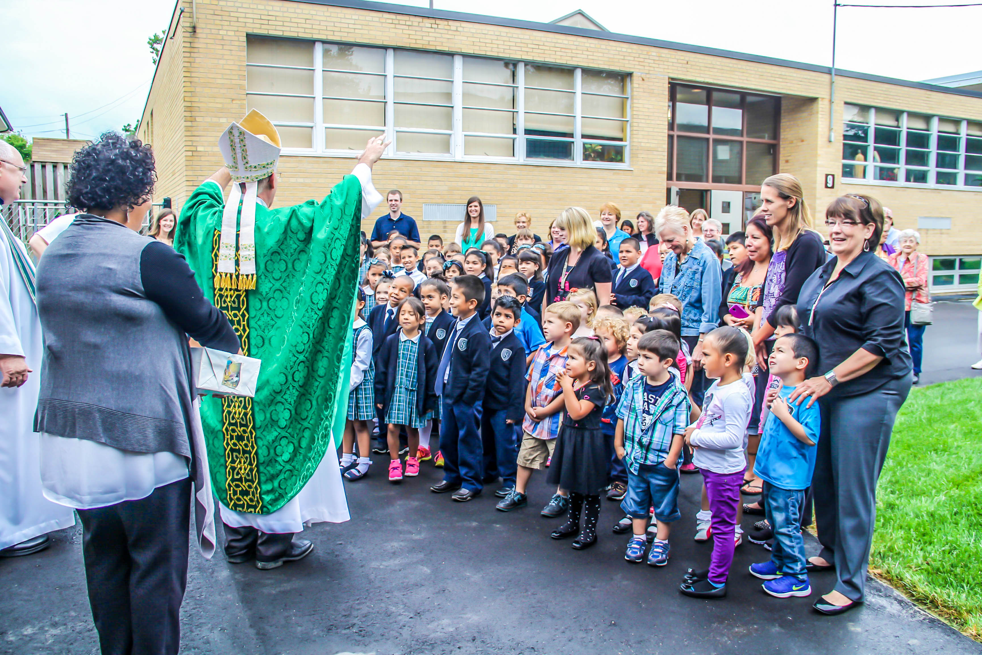
Q.
Can types of scholarships overlap?
YES!
Some students may be eligible to receive both a Choice Scholarship and an SGO Scholarship in the same year. School-specific assistance may overlap.
Notes:
Funded by private, charitable donations, Scholarship Granting Organizations provide scholarships to income eligible students to offset tuition costs at partnering schools. SGOs are part of the School Scholarship Tax Credit Program.
The Scholarship Granting Organization of Northeast Indiana (SGONEI) was founded in 2011. Our 43 Catholic schools in the Diocese of Fort Wayne-South Bend partner with the Institute for Quality Education as the Scholarship Granting Organization of Northeast Indiana.

Slide 13
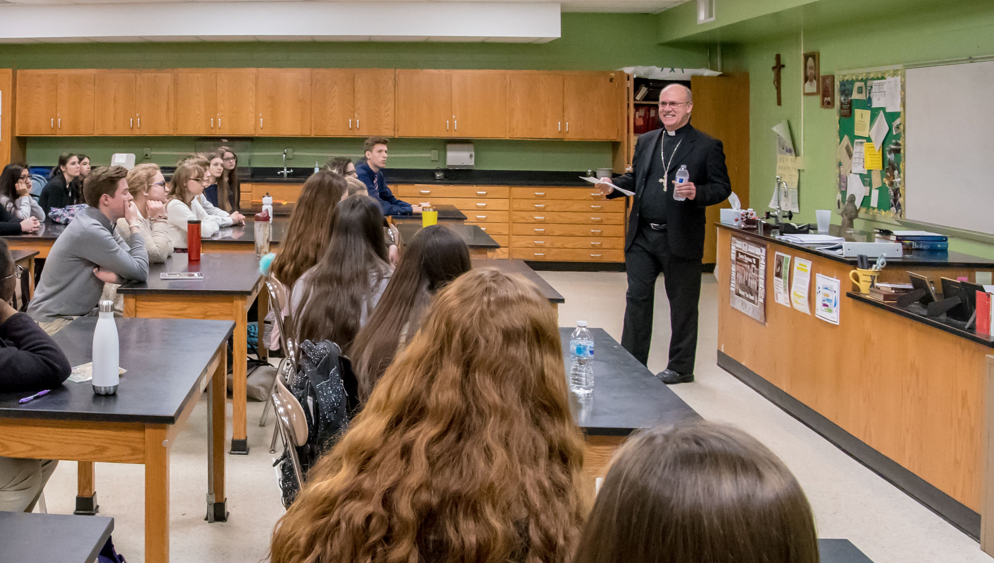
Q.
Can scholarships
be renewed?
YES!
Choice and SGO Scholarships are eligible for annual renewal with proof of income.
Notes:
Funded by private, charitable donations, Scholarship Granting Organizations provide scholarships to income eligible students to offset tuition costs at partnering schools. SGOs are part of the School Scholarship Tax Credit Program.
The Scholarship Granting Organization of Northeast Indiana (SGONEI) was founded in 2011. Our 43 Catholic schools in the Diocese of Fort Wayne-South Bend partner with the Institute for Quality Education as the Scholarship Granting Organization of Northeast Indiana.

Slide 14

APPLICATION PROCESS
Contact the school to find every financial assistance opportunity.
Enroll your child for
a quality Catholic education.
Apply for assistance.
The application is submitted by the school.
Many families are surprised to learn they are eligible for assistance they previously thought was unattainable
Notes:
Funded by private, charitable donations, Scholarship Granting Organizations provide scholarships to income eligible students to offset tuition costs at partnering schools. SGOs are part of the School Scholarship Tax Credit Program.
The Scholarship Granting Organization of Northeast Indiana (SGONEI) was founded in 2011. Our 43 Catholic schools in the Diocese of Fort Wayne-South Bend partner with the Institute for Quality Education as the Scholarship Granting Organization of Northeast Indiana.

