Slide 1
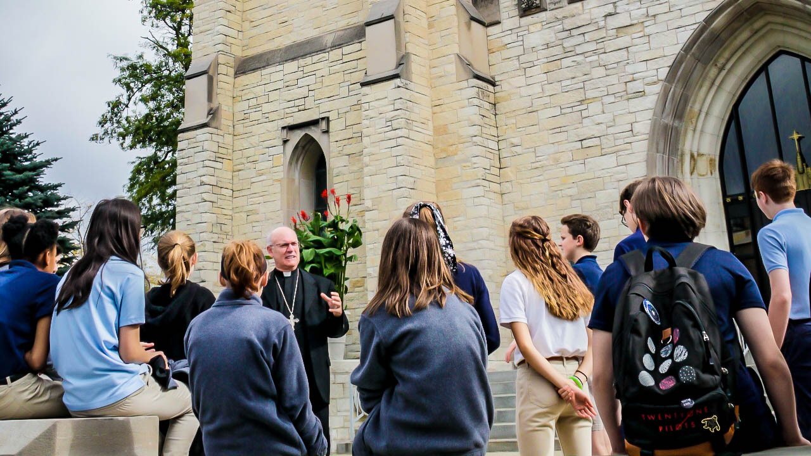

Slide 2
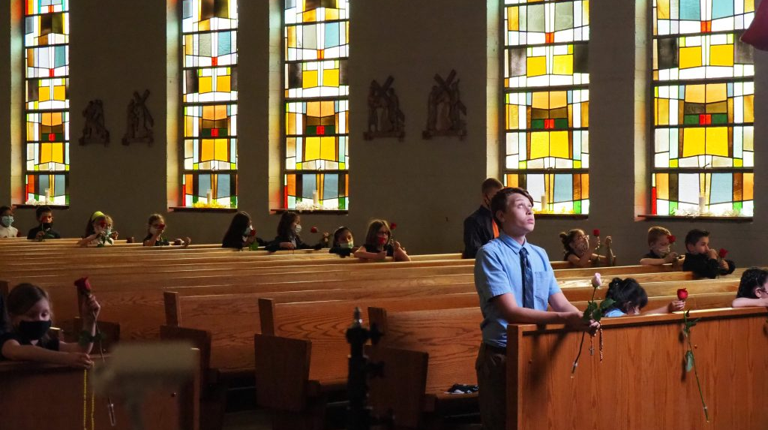
An Education for Eternity
Students develop a personal relationship with Jesus within His mystical body, the Church
Catholic schools are faith-filled communities where students are known and loved
Our schools help to form students into disciples of Christ

Slide 3

An Education for Eternity
We help students to fulfill their destinies to become saints
The ultimate goal of Catholic education is to form students for heaven
Catholic schools help to develop students’ minds, bodies, and soul​s.
The Catholic school assists parents, who are the primary educators of their children, in meeting their responsibility of educating their children in the teachings of the Catholic Church and of living a Catholic way of life.

Slide 4
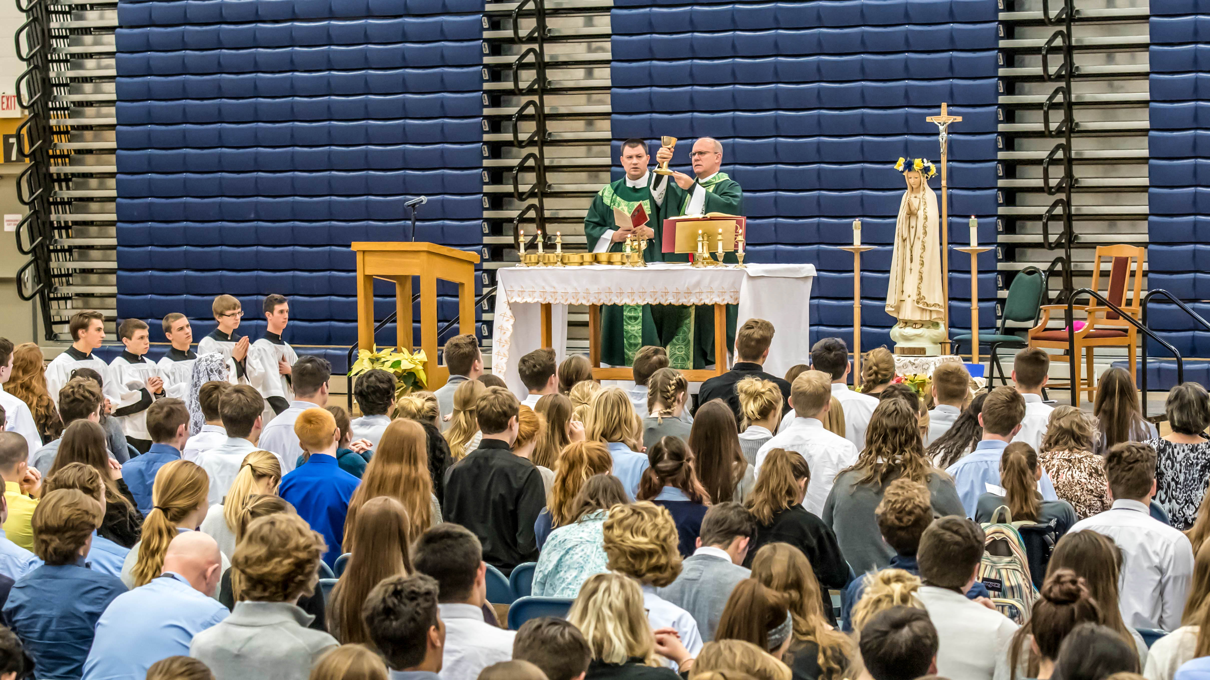
Scholarship Granting Organizations
Provides scholarships to income eligible students
Funded by private, charitable donations
SGOs are part of the School Scholarship Tax Credit Program.
The Scholarship Granting Organization of Northeast Indiana (SGONEI) was founded in 2011 to provide scholarships to attend the Catholic schools of the Diocese of Fort Wayne-South Bend.
Notes:
Funded by private, charitable donations, Scholarship Granting Organizations provide scholarships to income eligible students to offset tuition costs at partnering schools. SGOs are part of the School Scholarship Tax Credit Program.
The Scholarship Granting Organization of Northeast Indiana (SGONEI) was founded in 2011. Our 43 Catholic schools in the Diocese of Fort Wayne-South Bend partner with the Institute for Quality Education as the Scholarship Granting Organization of Northeast Indiana.

Slide 5
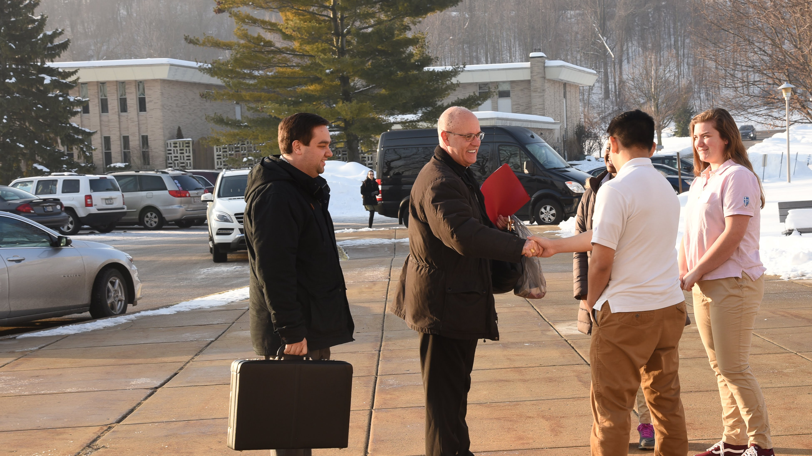
Q.
How is this different than Indiana Choice Scholarships (voucher)?
Choice Scholarships:
Publicly funded
Eligibility Track Requirements
SGO Scholarships
Private Donor funded
No track requirements
Notes:
Funded by private, charitable donations, Scholarship Granting Organizations provide scholarships to income eligible students to offset tuition costs at partnering schools. SGOs are part of the School Scholarship Tax Credit Program.
The Scholarship Granting Organization of Northeast Indiana (SGONEI) was founded in 2011. Our 43 Catholic schools in the Diocese of Fort Wayne-South Bend partner with the Institute for Quality Education as the Scholarship Granting Organization of Northeast Indiana.

Slide 6
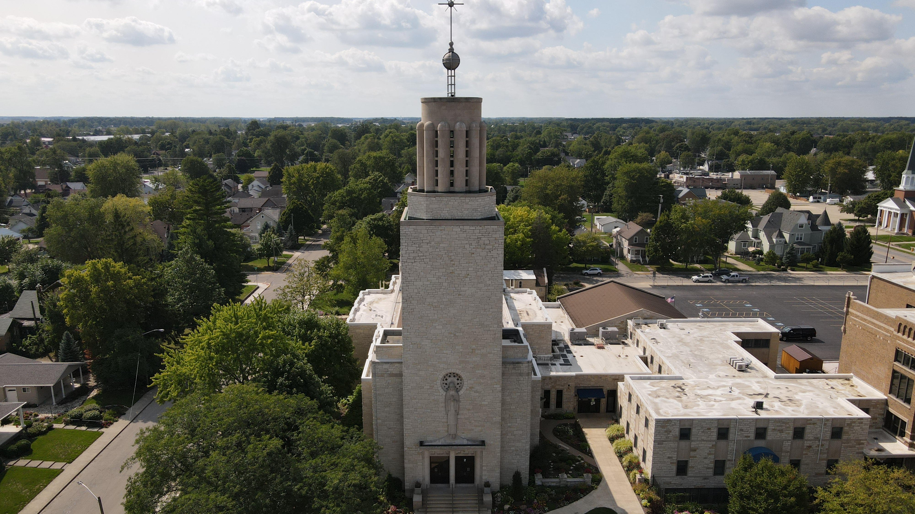

Student-Based Requirements
Families qualify for scholarships based upon the household income that is below 300% of the Federal Reduced Lunch guidelines.
*Income limits based on 300% Federal Reduced Lunch Guidelines, 2022-23
Notes:
Funded by private, charitable donations, Scholarship Granting Organizations provide scholarships to income eligible students to offset tuition costs at partnering schools. SGOs are part of the School Scholarship Tax Credit Program.
The Scholarship Granting Organization of Northeast Indiana (SGONEI) was founded in 2011. Our 43 Catholic schools in the Diocese of Fort Wayne-South Bend partner with the Institute for Quality Education as the Scholarship Granting Organization of Northeast Indiana.

Slide 7
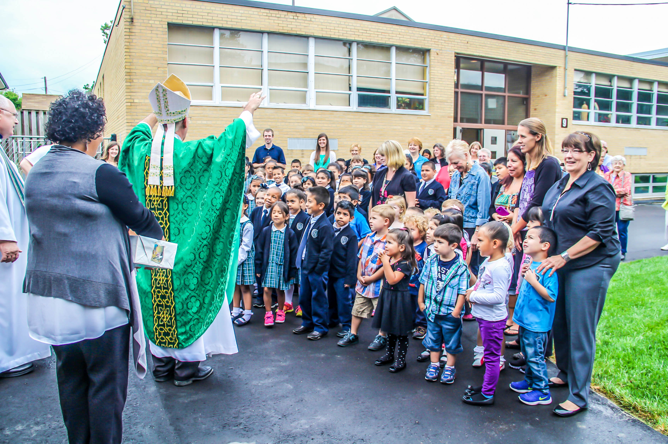
Q.
Can types of scholarships overlap?
YES!
Some students may be eligible to receive both a Choice Scholarship and an SGO Scholarship in the same year. School-specific assistance may overlap.
Notes:
Funded by private, charitable donations, Scholarship Granting Organizations provide scholarships to income eligible students to offset tuition costs at partnering schools. SGOs are part of the School Scholarship Tax Credit Program.
The Scholarship Granting Organization of Northeast Indiana (SGONEI) was founded in 2011. Our 43 Catholic schools in the Diocese of Fort Wayne-South Bend partner with the Institute for Quality Education as the Scholarship Granting Organization of Northeast Indiana.

Slide 8
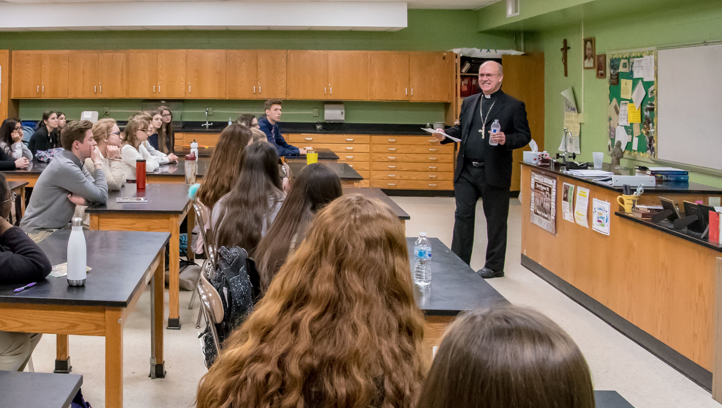
Q.
Can scholarships
be renewed?
YES!
Choice and SGO Scholarships are eligible for annual renewal with proof of income.
Notes:
Funded by private, charitable donations, Scholarship Granting Organizations provide scholarships to income eligible students to offset tuition costs at partnering schools. SGOs are part of the School Scholarship Tax Credit Program.
The Scholarship Granting Organization of Northeast Indiana (SGONEI) was founded in 2011. Our 43 Catholic schools in the Diocese of Fort Wayne-South Bend partner with the Institute for Quality Education as the Scholarship Granting Organization of Northeast Indiana.

Slide 9
APPLICATION PROCESS
Contact the school to find every financial assistance opportunity.
Enroll your child for
a quality Catholic education.
Apply for assistance.
The application is submitted by the school.
Many families are surprised to learn they are eligible for assistance they previously thought was unattainable
Notes:
Funded by private, charitable donations, Scholarship Granting Organizations provide scholarships to income eligible students to offset tuition costs at partnering schools. SGOs are part of the School Scholarship Tax Credit Program.
The Scholarship Granting Organization of Northeast Indiana (SGONEI) was founded in 2011. Our 43 Catholic schools in the Diocese of Fort Wayne-South Bend partner with the Institute for Quality Education as the Scholarship Granting Organization of Northeast Indiana.

